Slide 1
Employee Wellness and Emotional Health “Integrating Technology….Impacting the HR Experience.”
Office of the Services Commission Human Resource Practitioners Workshop
Thursday, March 2, 2023, 2:15 p.m.
Talk of the Town, Jamaica Pegasus Hotel
Facilitator: Rosemarie Voordouw
Associate Counselling Psychologist
John Maxwell Coach, Trainer and Speaker

Slide 2
Let’s get moving! Happiness (Ding Dong)

Slide 3
Desired Outcome: Develop strategies that will address employee emotional health and wellbeing to achieve work life balance
Objectives:
By the end of the Employee Wellness and Emotional Health Session, the participants will be able to:
Develop the skills to appropriately express their emotions;
Identify tools that may be implemented to improve employee morale;
Explore techniques to promote employee wellbeing;
Develop stress management mechanisms;
Identify strategies that may be used to develop emotional resilience;
Learn ways to create a healthy work-life balance.

Slide 4
Understanding the source of your emotions
Past experiences : triggers
Values
Attitudes
Beliefs
Perceptions

Slide 5
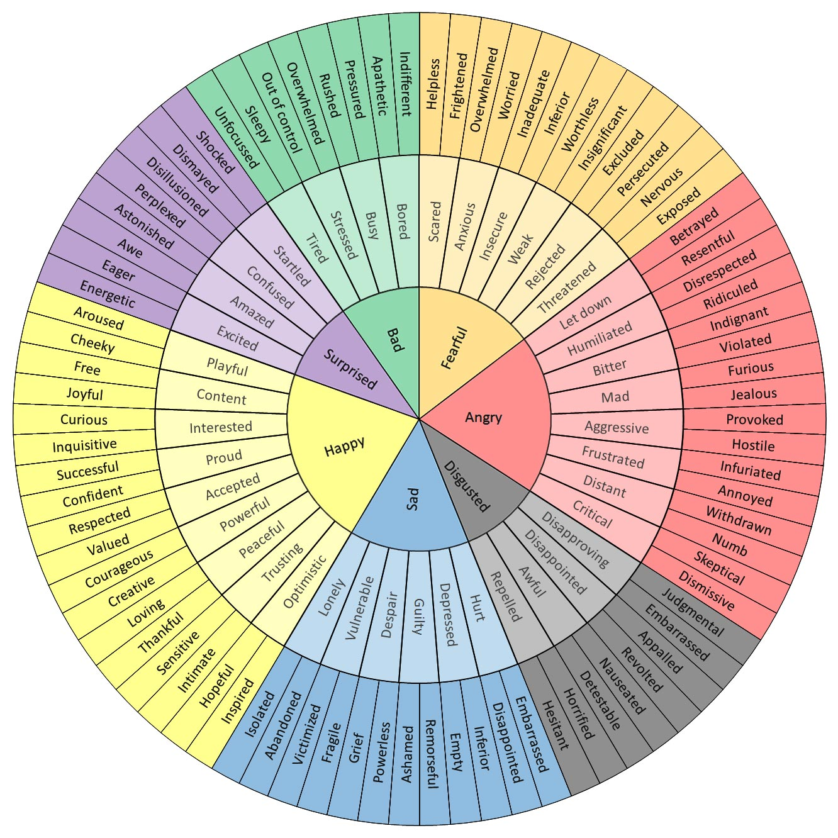

Slide 6
Activity: identifying and expressing emotions
Using the wheel if necessary, identify a (strong) emotion you experienced in the past week
What was the trigger for the emotion (e.g. a disagreement with a colleague/ family)
Now go deeper: can you identify the root cause of the emotion?

Slide 7
Expressing Emotions
Identify
Use “I” statements
Take accountability
Activity: Use this formula to express the emotion you identified earlier
Feedback

Slide 8
Emotional resilience
Resilience is the process and outcome of successfully adapting to difficult or challenging life experiences, especially through mental, emotional, and behavioral flexibility and adjustment to external and internal demands.
Emotional resilience is when you are able to “calm your frantic mind after encountering a negative experience”.

Slide 9
Elements of Emotional Resilience
Physical: state of health and healthy practices: sleep, eat, exercise
Mental and psychological
past trauma
Ability to adapt to change
Self-acceptance
emotional awareness and regulation skills
Ability to express emotions
Thinking habits
reasoning abilities
Social:
circles of community
culture

Slide 10
Circles of Community
Casual encounters
Bona Fide Friends

Slide 11
Factors impacting our ability to regulate emotions
Habit
Stress
Physical state
Grief
Intensity
Environment
Mental disorders

Slide 12
My top techniques to manage emotions
Learn your triggers
Challenge the emotion: test for rationality using ABC model
Centering
Gratitude
See it as a rainy day*
Build circles of community
Regular exercise
Get professional help ☺

Slide 13
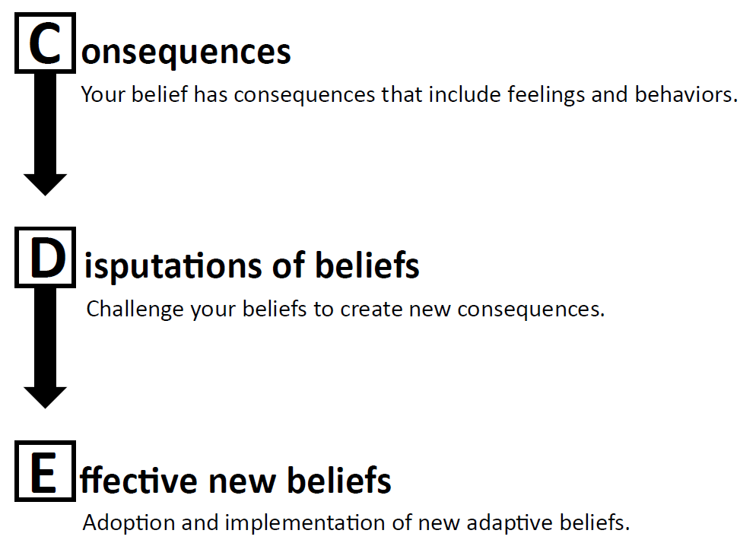

Slide 14
About those negative emotions… name them
Anger
Anxiety
Sadness
Fear
Shame
Guilt
Disgust

Slide 15
Activity
Think back to a time when you experienced a strong disturbing emotion
Use the ABC model to analyse the emotion
Did the emotion change after the analysis?

Slide 16
Learning Check
Use the EI Action Plan to cement your learning
Would anyone like to share?

Slide 17
Stand and stretch Break

Slide 18
Outcome 2: Employee well-being and morale: Plenary Discussion
Confidential Employee Feedback Mechanism
Fairness in promotion and compensation
Coaching practice
Mental Health Education campaigns
Clear targets and KPIs
Confidential dispute resolution process
De-stressing activities: fun days, games, exercise classes
Parenting programme
Community outreach programme
Nap room/no work break room
Encourage and coach time management

Slide 19
Outcome 2: Employee well-being and morale
Coaching Practice
Listening
What is going well
What needs improvement
Commitments: timeline, key performance indicators
Activity: (if time allows)

Slide 20
Learning Check: Employee well-being & morale
What idea/ideas can you explore further?

Slide 21
Stand and stretch Break

Slide 22
Outcome 3: Work-Life Balance & stress management

Slide 23
Work –life balance: Life Wheel
Activity: draw your own life wheel
What adjustments would you like to make?

Slide 24
Stress Management
5
myths
basic truths
stress management tools
2
3

Slide 25
5 Myths: True or False?
Stress is not real. It is an excuse some people use to get out of doing things
Stress is internal it is not something that happens to you
Once I learn enough stress management tools I will eliminate stress from my life
Everyone feels the same amount of stress in a challenging situation
I can be at peace in situations that are stressful

Slide 26
2 Basic Truths you should know
Some stress is the result of trauma experienced earlier in life or behavioural thinking habits we have developed These may need professional help
Mens sana in corpore sano: you will manage stress better if your body is healthy

Slide 27
Stress Management Tool #1:. Focus on what you can control: The Story
John is a young professional working in a company he had always wanted to join. At his level the job involves rotating through various supervisors. So far, about a year into the job, he has been enjoying the experience and receiving great positive feedback from the supervisors. Then he heard it was time to work with the most difficult supervisor in the company.
This supervisor is legendary for making the lives of his reports miserable. No one lasts more than a week with him. He has links to the highest level of the company, so her has been getting away with this behavior for years.
John found the supervisor to be worse that his reputation. He criticized his work harshly, changed instructions last minute, took the credit when things were done well and blamed John when things went wrong.
John is suddenly having problems sleeping, has lost his appetite has no desire to go to work and is making mistakes he would not normally make

Slide 28
Stress Management Tool #1: Circles of Control
Influence
I Can’t Control
I Can Control
Examples:
What I do
Where I choose to FOCUS my brain
My Opinion
My prejudices
My perceptions
My preferences
My choices
Examples:
What others do
What others think
What others say
How others feel
Other’s Opinion
Other’s prejudices
Other’s perceptions
Other’s preferences
Some Systems
Past Events
The thoughts that come to me
Acts of Influence Examples
Change my focus
Identify effective strategies to influence my desired outcome
Choose my words, tone & time of communication
Practice mindfulness
Let go of unrealistic expectations
Research possibilities
Hold myself accountable
Process
Outcome

Slide 29
Stress Tool #2: Circles of Control
You cannot control many of the events that occur in your life, other person’s actions and thoughts, systems and many things in life
You cannot control your thoughts: they are visitors
These thoughts give rise to feelings
BUT you CAN control what you choose to FOCUS on in your brain
You can also choose acts and attitudes to INFLUENCE your desired outcome
The Circles of Control help you to change your focus:
from what you cannot control and the outcome
to what you can control and the process

Slide 30
Stress Management Tool #2: Prioritise the Important over the Urgent: The Story
Shelly is part of a unit that has continued to work from home even after Covid restrictions were lifted.
She was secretly hoping to go back into office.
She finds that when she is at home she is distracted by her young daughter, who prefers to stay with her even though she has a nanny, things she sees to do around the house and her phone.
To make it worse, the company has laid off persons in her department and spread their duties among the remaining staff. She is finding it difficult to meet her deadlines an is consistently late with deliverables.
Recently she has been getting sick quite often, she is short-tempered with everyone, even her daughter and has no interest in doing the things she usually enjoys, like playing badminton and going to the beach

Slide 31
Stress Management Tool #2: Prioritise the Important over the Urgent: The Tool
Important
FOCUS
Opportunity & Planning
Think critically
Big picture
MANAGE
Fire-fighting
Demand & necessity
AVOID
Illusion/deception
Not your emergency
Minimise investment
LIMIT
Waste /escape
Entertainment
Use to manage stress
Not Urgent
Urgent
Not Important

Slide 32
Stress Management Tool #3: Live in the Present: The Story
Jennifer finds that she is always on edge and never able to relax. At work, and even when she is supposed to be having fun, she is always worrying about something. When her friends point it out her, her response is: “Worrying helps me to prepare for bad things to come. And bad things ALWAYS come.”

Slide 33
Stress Management Tool #3: Live in the Present: The Tool
Live Mindfully
Mindfulness Exercise

Slide 34
Learning Check: Full Seminar
Top Learning points

Slide 35
WhatsApp : 876-552-2130. IG@actualiseu

